Slide 2
Inflation is back
Inflation has come back quickly.
Switzerland: comparatively tame, currently 3%. Why?
Started from 0%.
Fossil fuels have comparatively low weight in Swiss CPI.
Administered prices are 27% as opposed to 10% in euro.
SNB reacted quickly: It allowed CHF to appreciate by >6% even before raising policy rate.

Slide 3
Interest rate strategy
Raise interest rate until forecasted inflation is acceptable.
No one-sided FX interventions (maybe to smooth in both directions).
☺ Monetary policy is “back to normal operation.” Bond investors receive “positive returns” again.
☹ Balance sheet remains large, unless losses are accumulated.
☹ Some risk for financial stability (debt) if rates rise quickly.

Slide 4
Balance sheet strategy
Stop raising interest rate.
Gauge monetary policy by selling FX assets in order to appreciate CHF as necessary.
Swiss version of QT (opposite of interventions of the last 12 years).
☺ Balance sheet is actively reduced by one-sided interventions.
☹ Challenge for export-oriented industry.

Slide 5
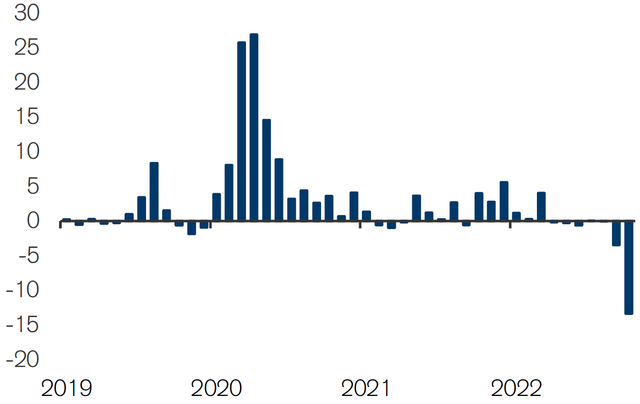
What does it intend to do?
Martin Schlegel has been quoted saying that SNB has no intention to shrink or enlarge balance sheet.
Yet, it appears that it has sold CHF 17 billion in September and October this year.
To be observed…
Source: Credit Suisse

