Slide 2
Should SNB pay interest to banks?

Slide 3
The Old Normal
Small CB balance sheets.
No interest paid on reserves.
Commercial banks hold only limited reserves at CB. Cost of non remuneration is small.
CB keep reserves scarce to control interest rate on interbank market.
Scarcity keep interbank market active.

Slide 4
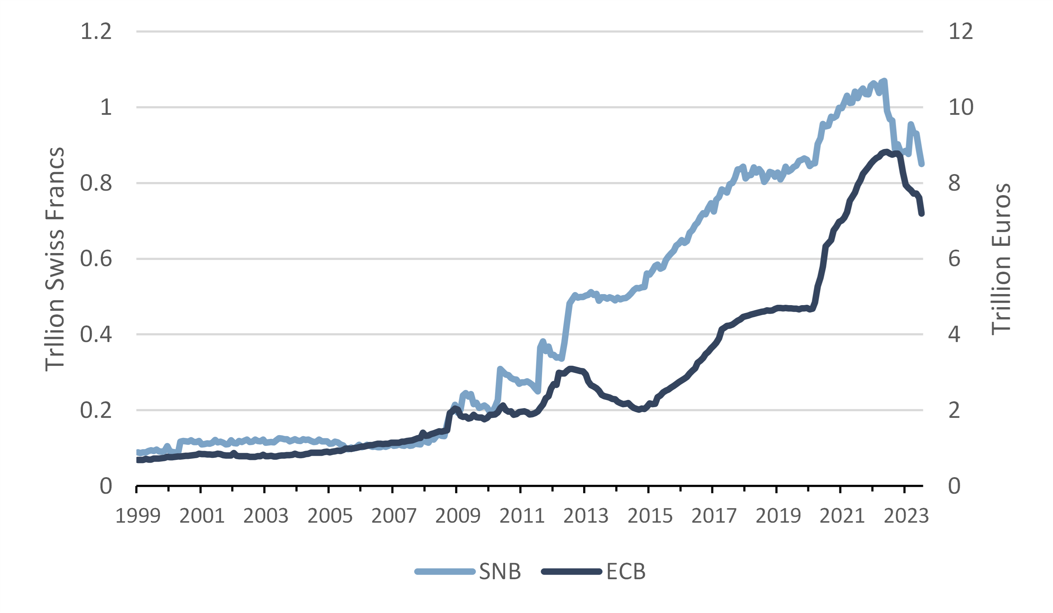
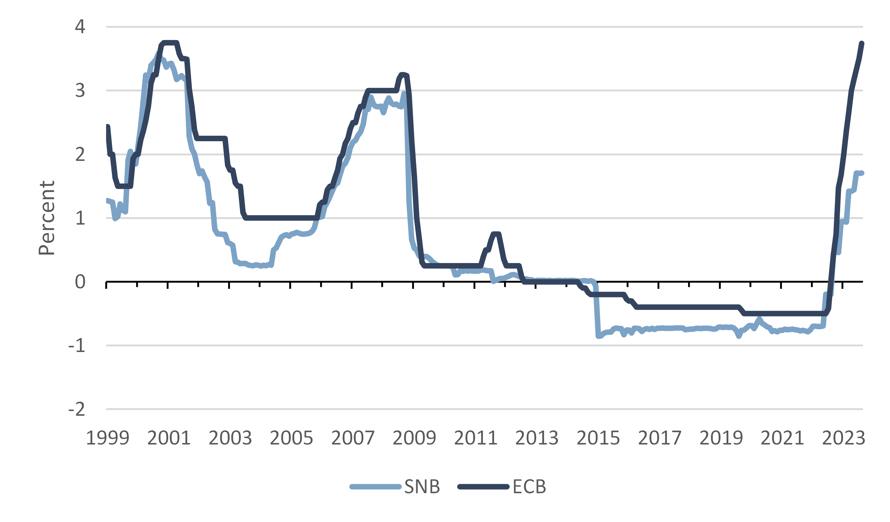
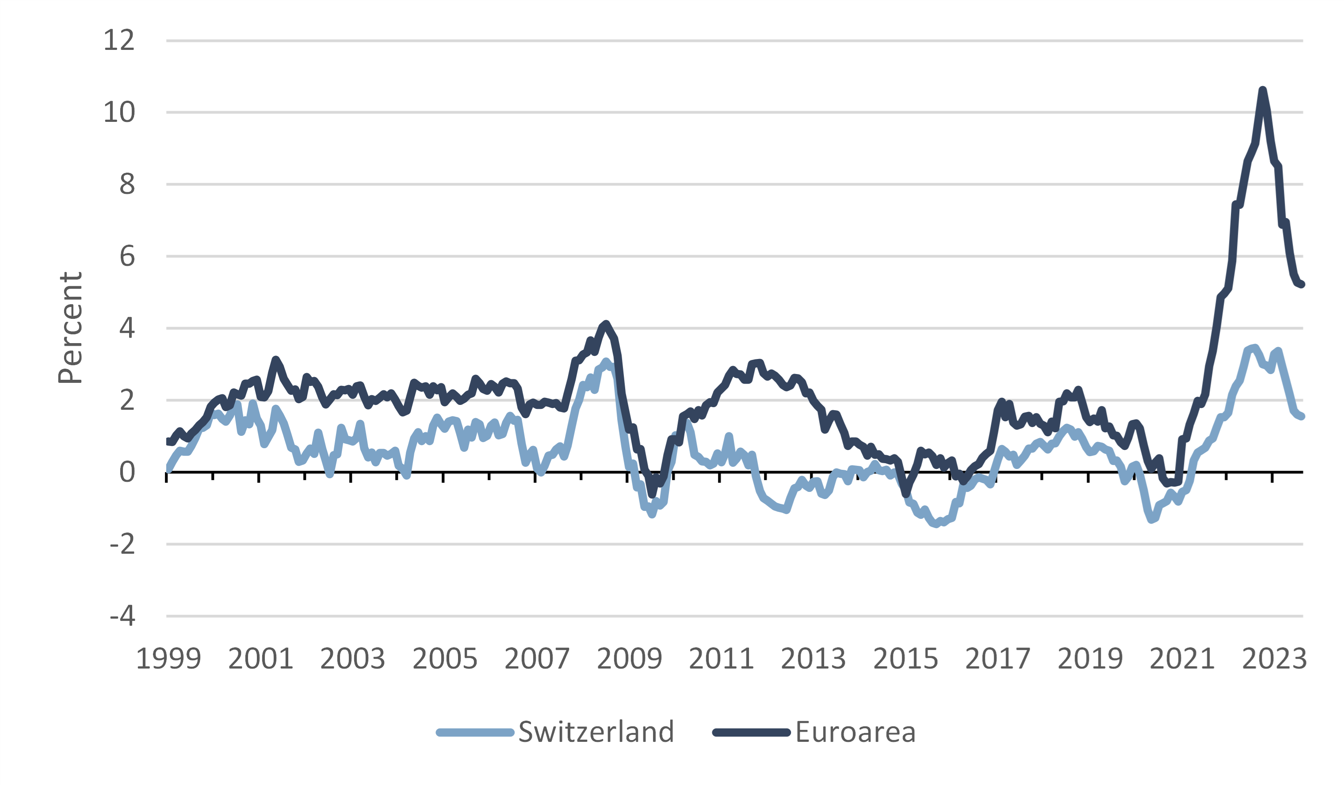
CB balance sheet
Policy rate
Inflation rate

Slide 5
Quantitative Easing Era
Policy rate drops to the lower bound - below zero at places.
CBs greatly expand their balance sheet.
Banks hold excess reserves.
Abundant reserve regime is the new normal.
Interbank market with excess supply: CBs set floor for interest rate by paying policy rate on reserves.
Where the policy rate is negative, banks pay to hold reserves.
Tiering system to relieve banks from financial strain, for fear of financial instability.

Slide 6
CB balance sheet
Policy rate
Inflation rate

Slide 7
Post QE
Resurgence of inflation prompted CBs to raise policy rate.
Also, attempts to reduce CB balance sheet (quantitative tightening).
(This is challenging…)
Some CBs now pay positive interest to banks on their reserves.

Slide 8
CB balance sheet
Policy rate
Inflation rate

Slide 9
The cost is significant
Cost depends on size of reserves and level of interest rates.
Rates in CH are lower than in most places …
… but SNB’s balance sheet is huge.
In the first 6 months of 2023, SNB paid CHF 3.4bn as interest to banks.
Extrapolating, this is more than the max CHF 6bn distributed to the govt.

Slide 10
What to do?
Difficult decisions lie ahead.
Go back to scarcity of reserves?
If not, reserves must be remunerated.
Is tiering necessary? In what form?
Objectives: 1) Control interest rate on interbank market; 2) keep interbank market active.
Many options are possible.
Example 1: the SNB pays policy rate on first tier, less on second.
Example 2 (the ECB): pay no interest on required reserves and policy rate for the rest.
Example 3: no tiering but nonbanks admitted on interbank market.
Example 4 (Fed): allow only major banks access to SNB balance sheet. This forces activity on interbank market for smaller banks.
Combinations of above.

Slide 11
A warning
SNB acted today
With a large footprint and significant costs, the SNB faces difficult decisions.
Need to evaluate ways to reduce cost.
This calls for proper communication.
A task for the SNB and its Bank Council.
SNB has announced today that it will no longer remunerate minimum reserves.
It has also shrunk the fully remunerated tier.
https://www.snb.ch/en/publications/communication/press-releases/2023/pre_20231030
As usual, the Board of the SNB had received our report last week.

