Slide 2
Looking back : inflation record
Inflation record is better than most other central banks.
Although inflation was long hovering around 0%, often below target.
SNB acted quickly after the recent surge of inflation.

Slide 3
Central banking ≠ Monetary Policy
Need a balance between the interests of the SNB and those of the public at large.
Example: accumulate capital at the expense of profit distribution.
Too conservative attitude towards emergency liquidity provision.
Gender gap: women are about 1/3 of the staff and get about 1/6 of the promotions to the senior staff.
SNB opaque which makes it difficult to hold it accountable.

Slide 4
Looking forward : new member
Board is comparatively inexperienced and lack “gravitas.”
New member should expand range of competencies beyond experience gained at the SNB.
Time to return to the 2-outsiders, 1-insider formula.
Presidency should be decided after new member is known. No automatic right of succession.

Slide 5
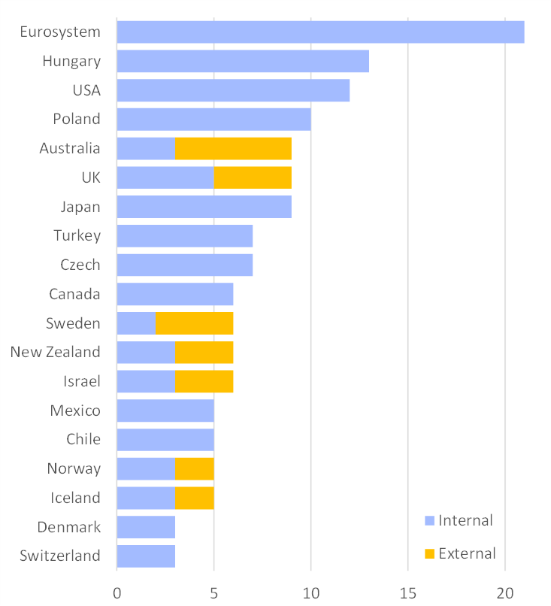
Looking forward : medium term
Enlargement of board would offer possibility for members with a broader set of experiences.
Monetary policy committee (separation of management from policy decisions) desirable.
Bank Council too weak and unable to challenge SNB management.
Number of voting members
-> see our Governance report

