Slide 1


Slide 2
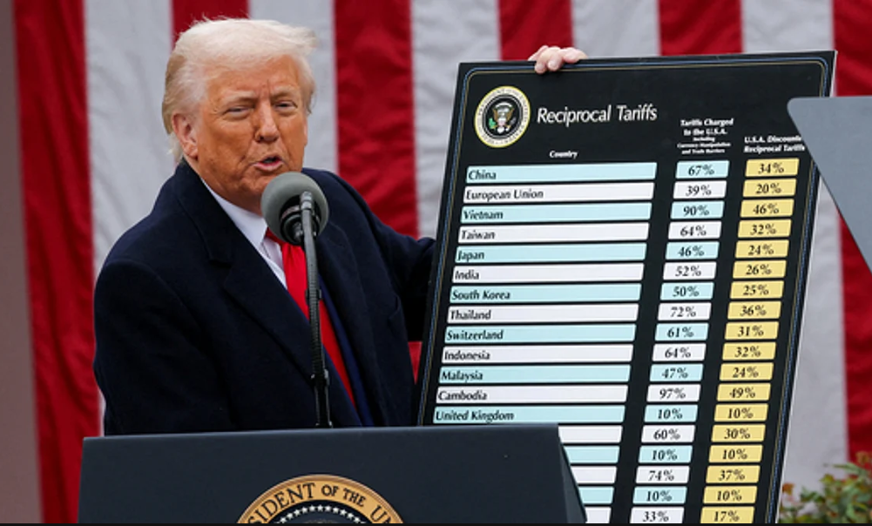

Trump’s tariffs:
What role for the SNB?

Slide 3
Tariffs vs FX: Two cases
Full offset
  Devaluing CHF by 39% would keep US import price after tariffs unchanged.
  CH exports to other countries would be cheaper.
  CH imports would be 39% more expensive.
Partial offset
  US-share of Swiss exports in 17%. Devalue by 17% x 39% = 6.5%
  Still a large number with little effect in the US

Slide 4
What can or should the SNB do?
If economy cools down and inflation declines, it will have to be more expansionary (neg rates, interventions).
Even if that does not happen, SNB might be able to support a declining CHF.
Design a substantial depreciation is difficult because:
  SNB balance sheet would become even larger.
  Danger of being accused of currency manipulation (with consequences).
SWF could help isolate SNB from this critique.
  Possible that FX operations would be better accepted if done my SWF instead of central bank.

Slide 5
No attractive option

Slide 6
(additional slides)

Slide 7
Random tariff rates
CH-US trade balance dominated by pharmaceuticals and gold.
In a highly globalized world, bilateral trade balances are not very informative …
… but they seem to guide the US tariffs anyway.
39%
or more ...
or less …
and on what ?

Slide 8
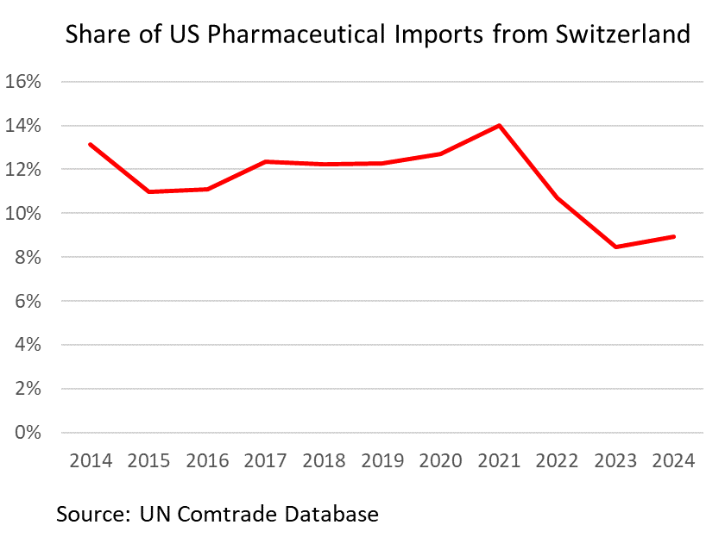
Pharmaceuticals: more uncertainty
Trump has threatened escalating tariffs on pharmaceutical goods to force lower prices for US customers.
In 2023, CH pharma exports to USA account for 3.5% of CH GDP.
This could hurt Swiss business cycle.

